Slide 1
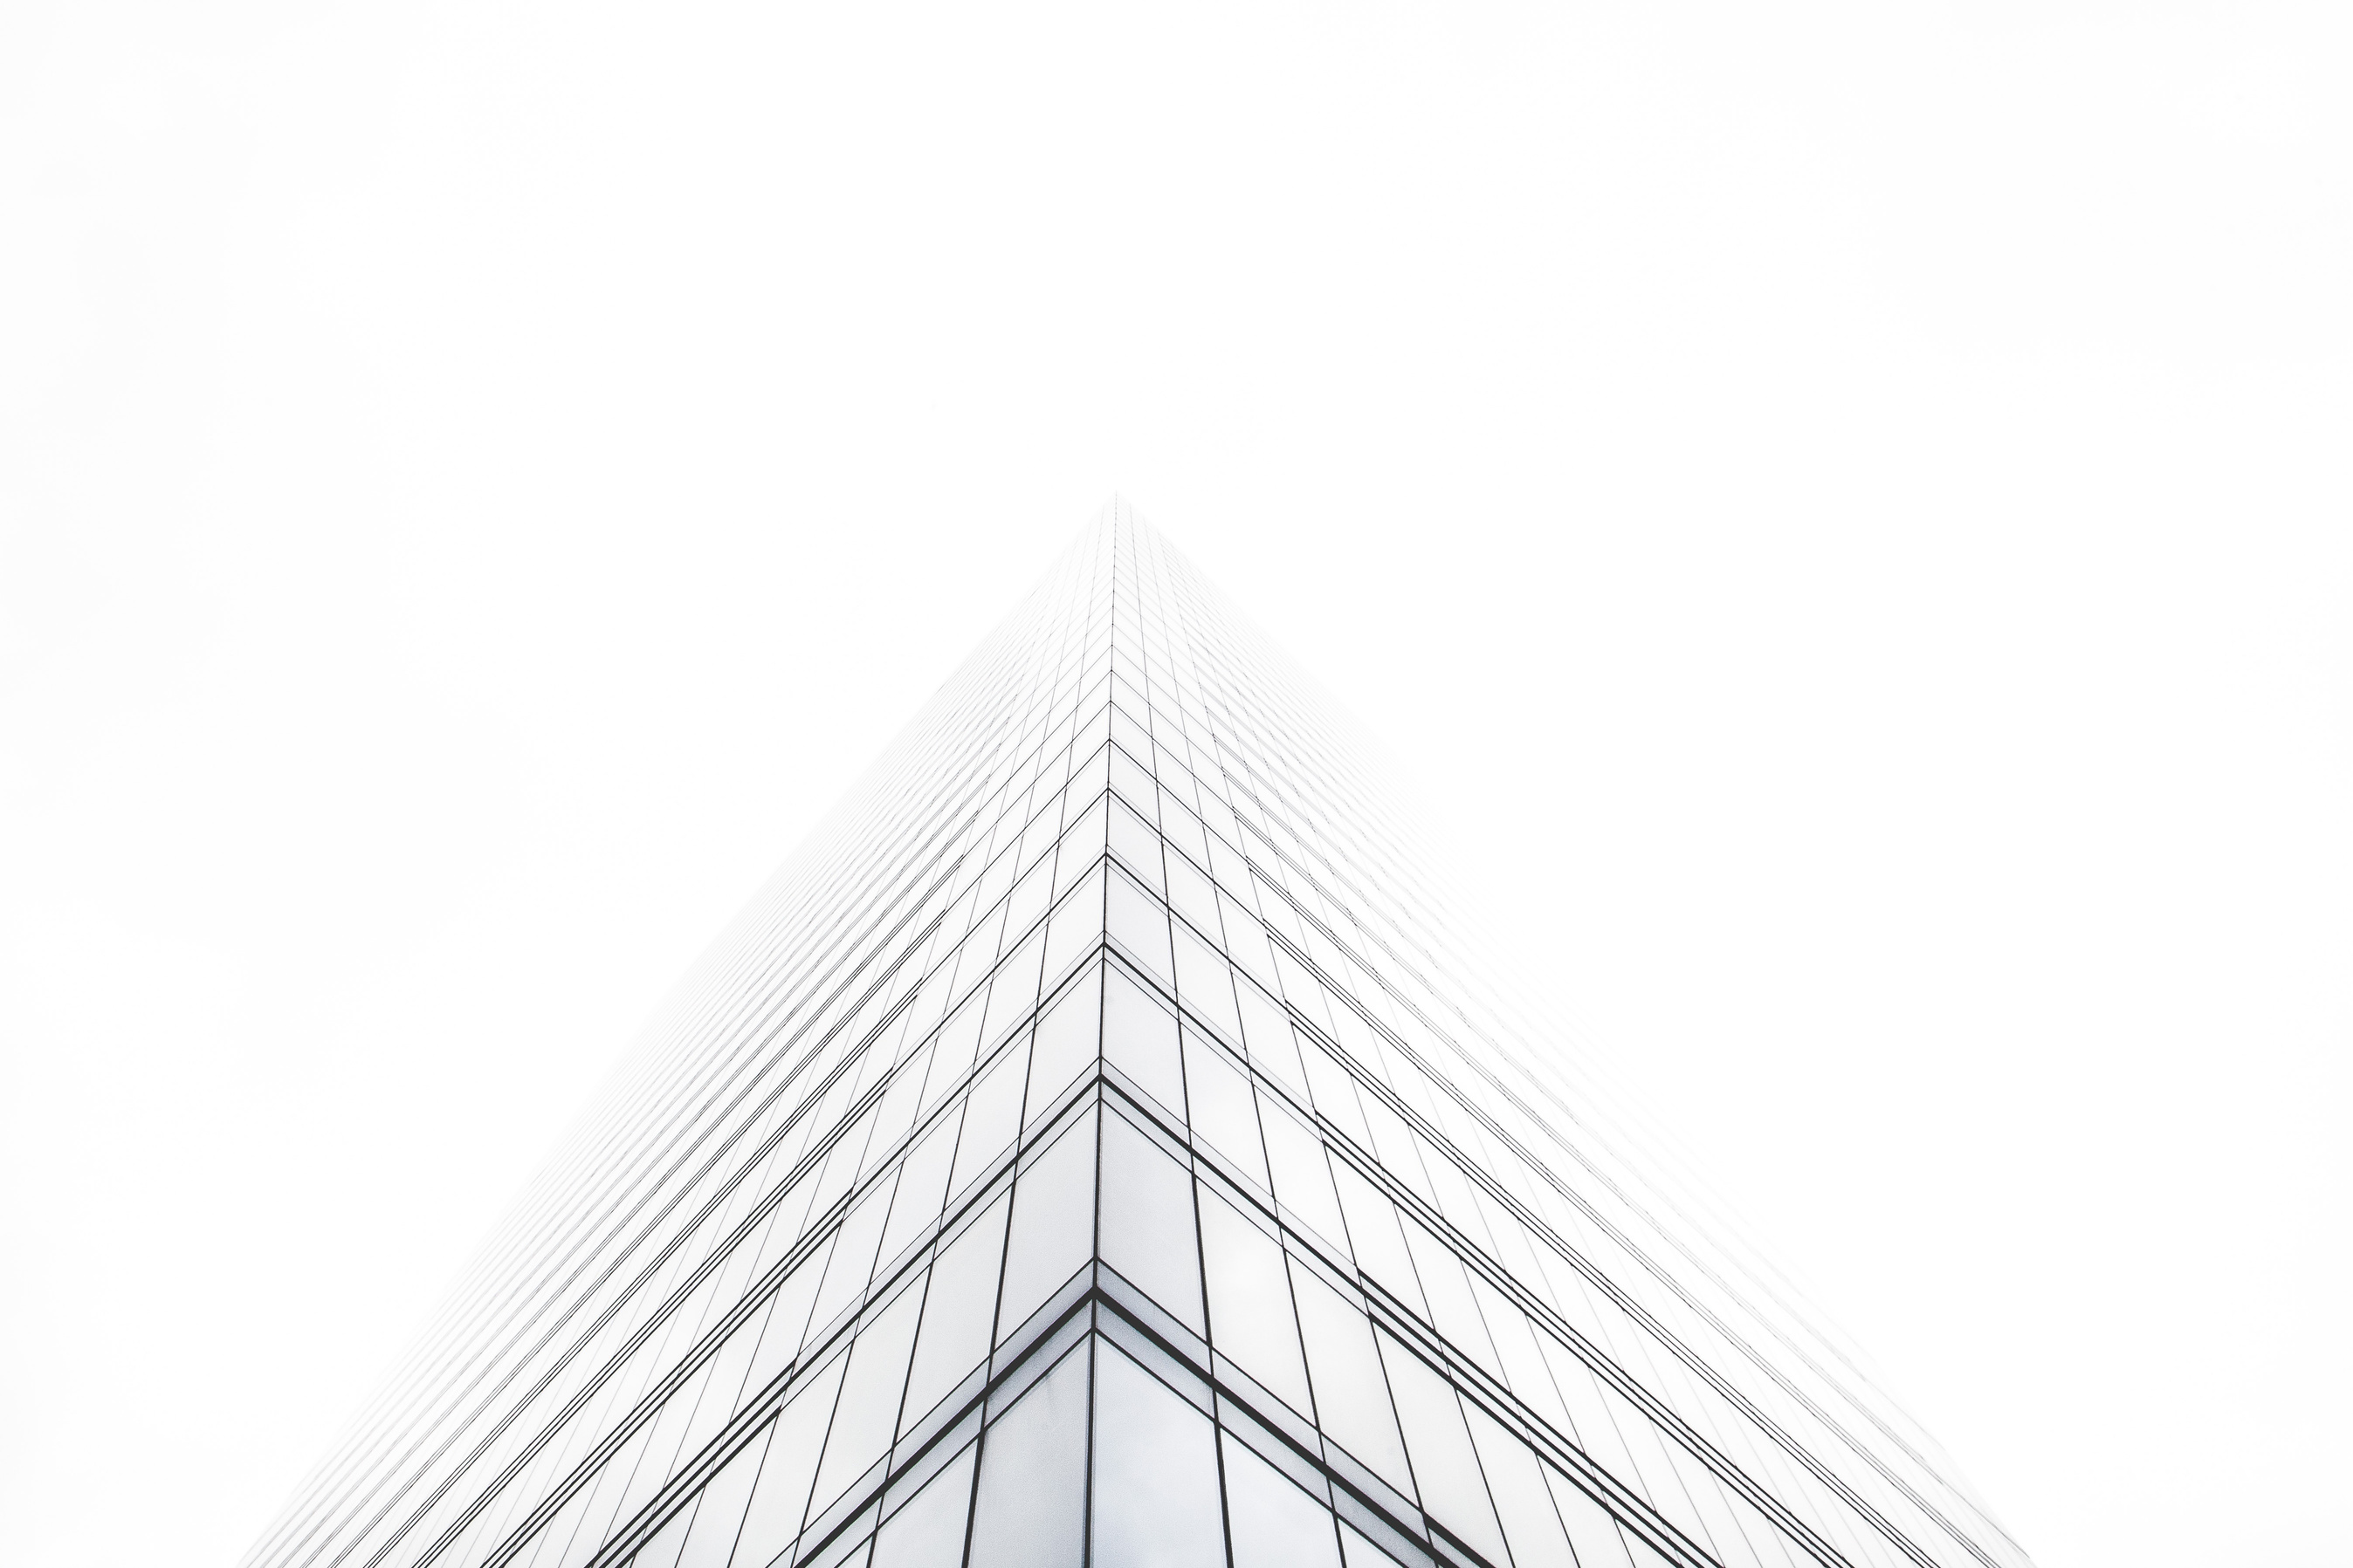
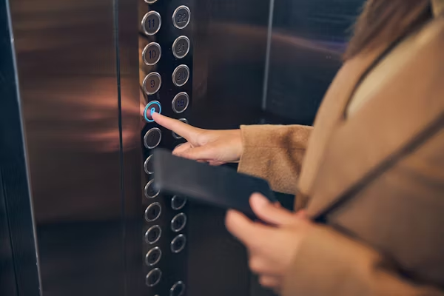

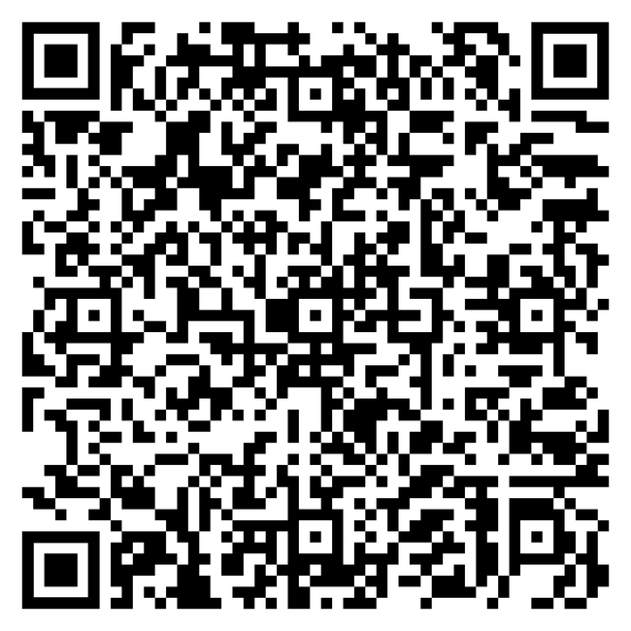

Alaina Enterprise
Profile
+88 01819833911
+88 01805032400
Passenger Lift
Rooptop Solar
Sub-Station
info@alainaenterprise.com
www.alainaenterprise
Flat-1/B, House-508 (2nd Floor)
Road-7, Ave-3, DOHS, Mirpur-12, Dhaka,Bangladesh.

Slide 2

About Us
Who We Are
ALAINA ENTERPRISE provides one-stop solution for Elevators, Electrical houses and industrial solution generators and civil works. Depending on the size and ﬁeld of your organization, we have diﬀerent products and services to meet your business requirements. We provide optimum and customized solutions to accelerate your business and organization.
ALAINA ENTERPRISE began its business operation as an enterprise passenger elevator, civil works, electrical industry, and house wiring large and small buildings, industries, and government sectors.
ALAINA Enterprise focuses exclusively on high-quality and cost- eﬀective service implementation. We are advancing at a tremendous pace and with the involvement of skilled and experienced people working in the organization. ALIANA ENTERPRISE is currently doing business in Government.

Slide 3

Our Mission & Vision
Vision
Mission
Our Mission is to achieve the reputation of a quality, high-standard & reliable solution & service Provider Company for various types of companies Industry."
This sentence couldbe improved for clarity and grammar. Here'sa revised version:
"Our mission is to build a reputation as a high-quality, reliable, and standards-driven provider of solutions and services for companies across
Our Vision is to achieve 100% customer satisfaction by delivering quality products and servicesat an affordable cost. Our forward visionis to strive to become an entity in technology-based corporate solutions, capable of demanding an unconditional response from the targeted niche. We also believe that for our scope of improvisation – the sky is the limit and we are always readyto take our achievements to the next level. We are growingand would always like to remain on the growing streak.

Slide 4
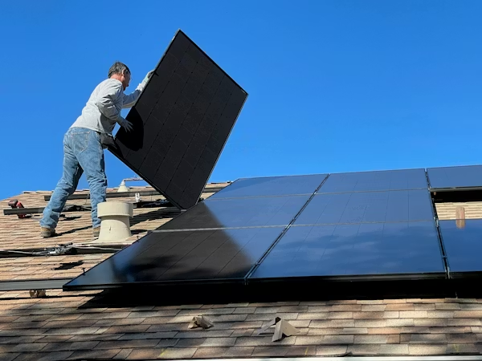
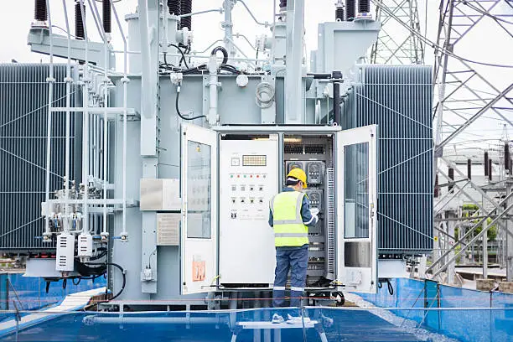
Our Products
Passenger Elevators
Rooftop Solar
Sub-Station

Slide 5
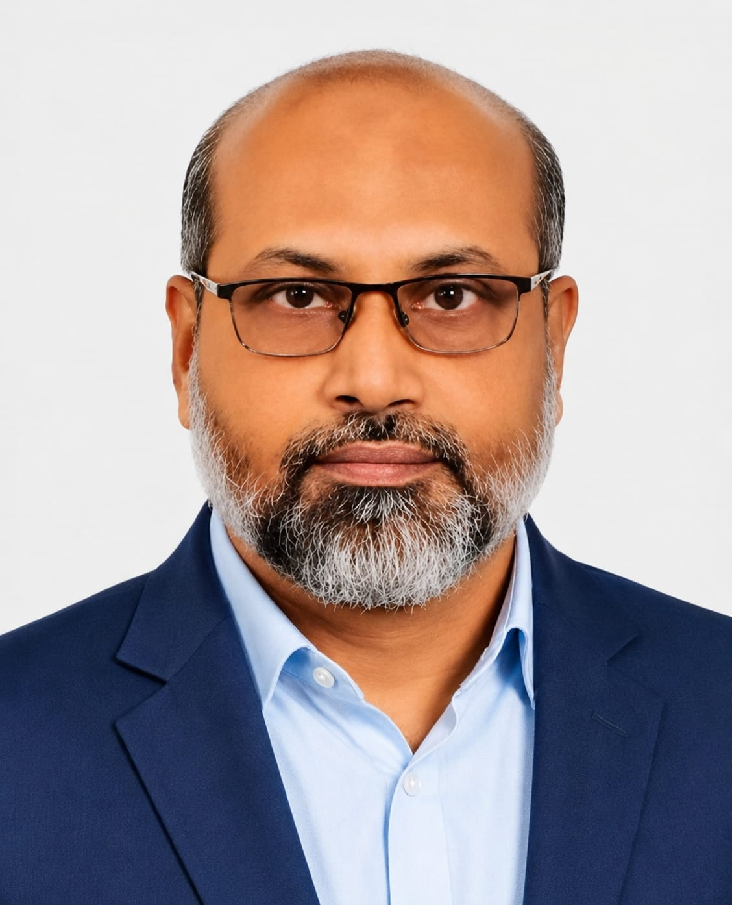
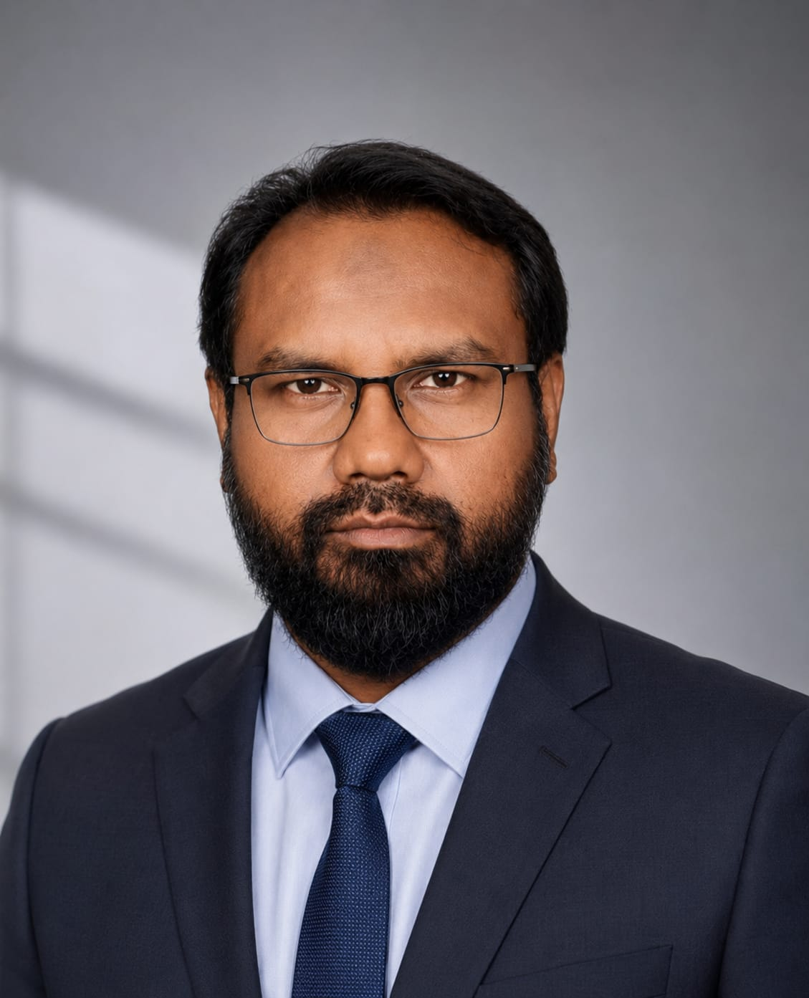
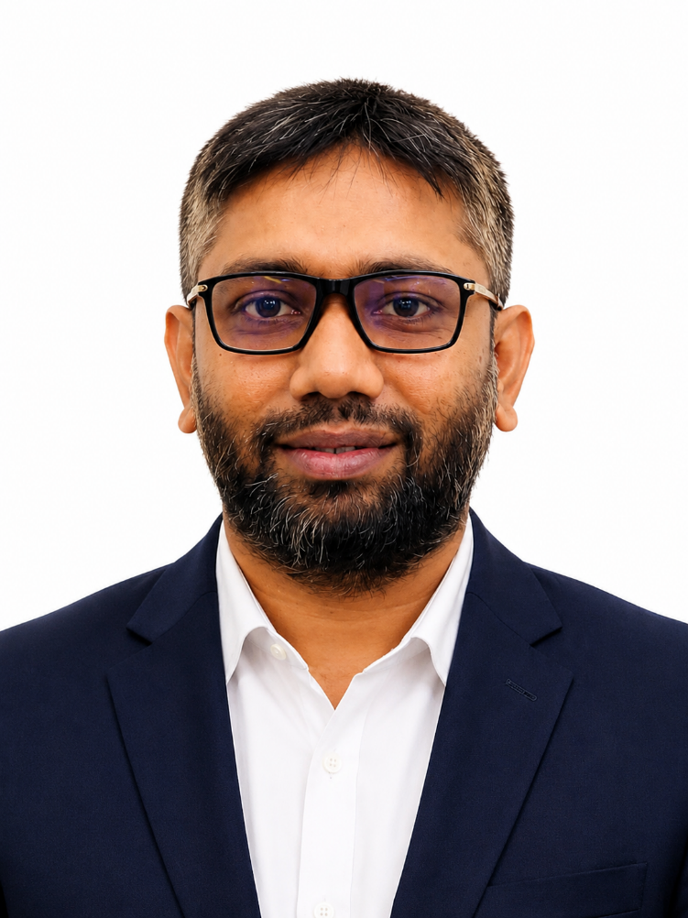
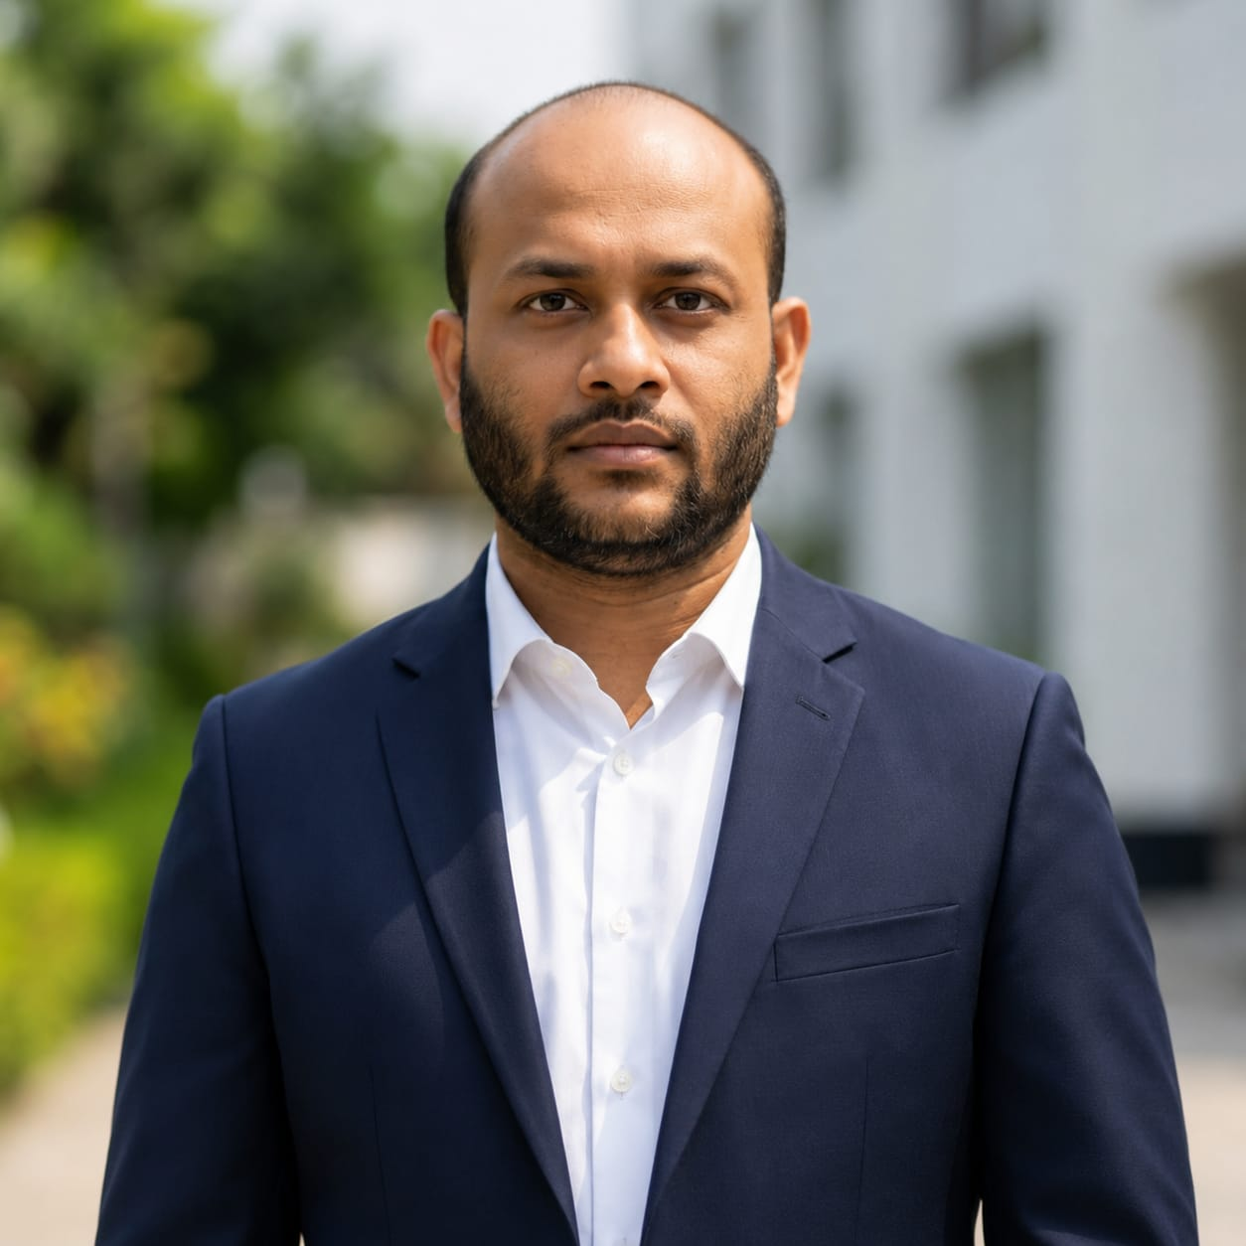
Meet Our Team
MD.Mainul Haque Moin
Md. Lokeman
Md. Morshed Alom
Mehedi Hasan Mohin
Chairman
Managing Director
Director Marketing & Sales
Director Marketing & Admin

Slide 6


Our Service
We are committed to delivering reliable and high-quality engineering solutions.” “Customer satisfaction and long-term partnership are our top priorities.” “Our experienced technical team ensures efficient and professional service support.” “We provide end-to-end solutions tailored to client requirements.” “Quality, safety, and performance are the foundation of our services.” “We believe in sustainable solutions and continuous technical innovation
Passenger Lift sell & Maintenance
Rooptop Solar sell & Maintenance
Sub-Station sell & Maintenance
“We provide complete elevator and lift solutions including sales, installation, maintenance, modernization, and technical support for residential, commercial, and industrial projects.”
“We provide complete solar energy solutions including design, supply, installation, commissioning, maintenance, and technical support for residential, commercial, and industrial sectors.”
“We provide complete substation solutions including supply, installation, testing, commissioning, repair, and maintenance services for industrial, commercial, and utility sectors.”

Slide 7
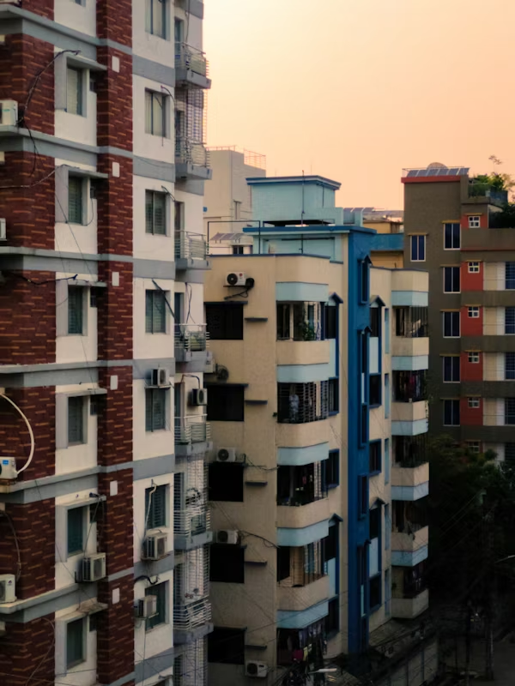
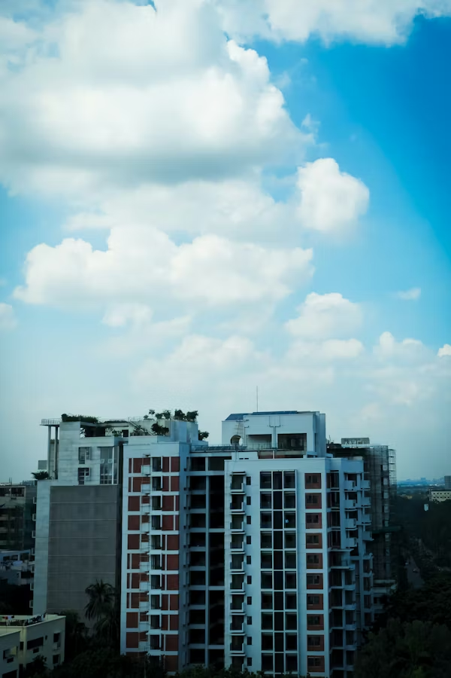
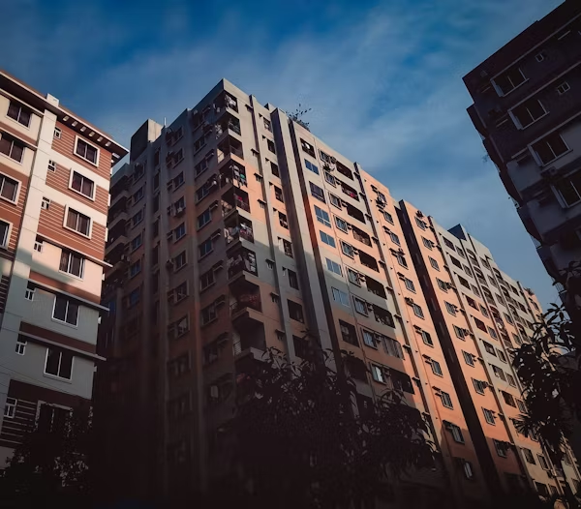
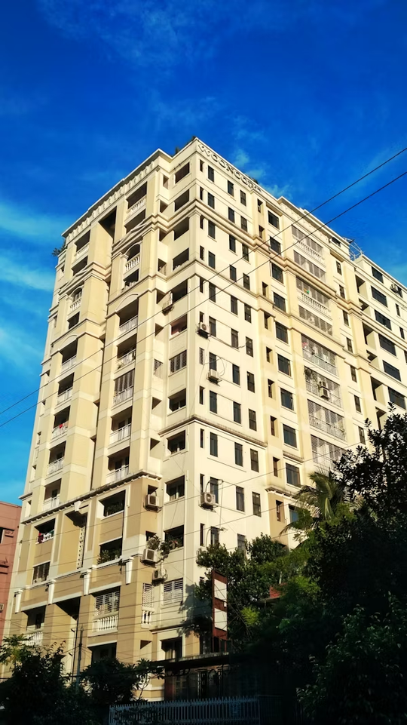
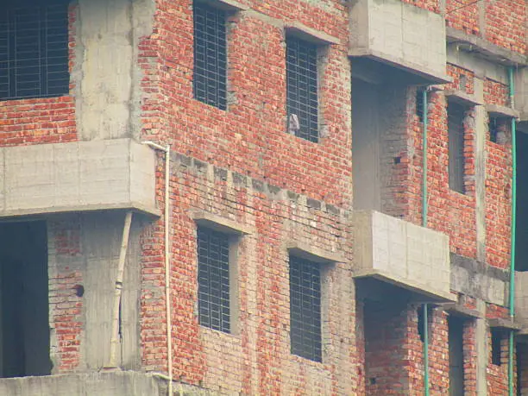
Our Project
Dream Korobi
Shpno Bilash
Kholifa Tower
xx
xx

Slide 8







Our Partner

Slide 9

Thank You
+88 01819833911
+88 01805032400
info@alainaenterprise.com
www.alainaenterprise
Flat-1/B, House-508 (2nd Floor)
Road-7, Ave-3, DOHS, Mirpur-12, Dhaka,Bangladesh.

